Slide 1

DEPI
CyberSecurity
FALCON
Under supervision:Eng/Khaled Abdrabo

Slide 2
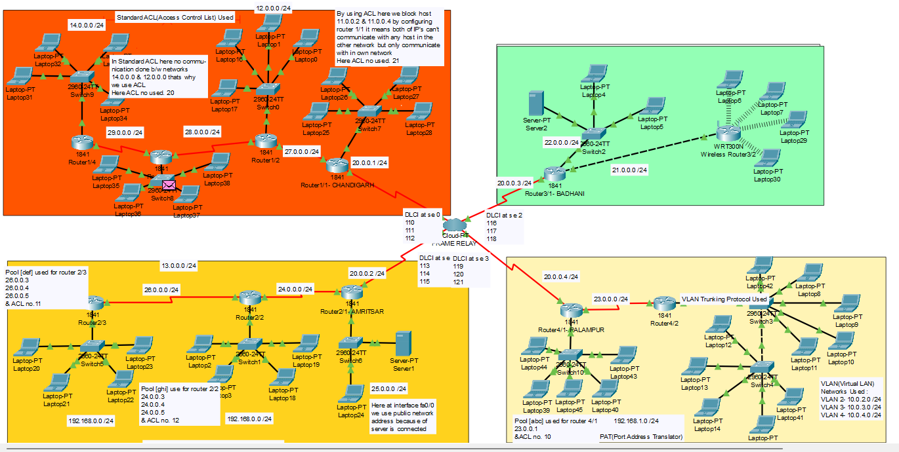
OVERVIEW

Slide 3
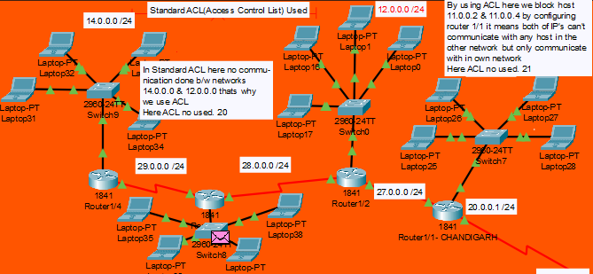

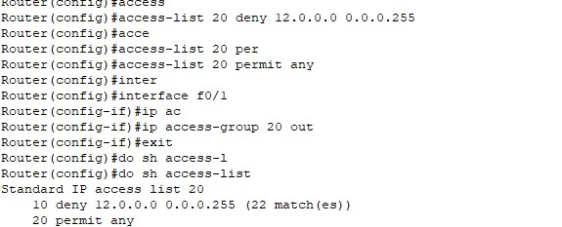
Standard ACL configraiont

Slide 4
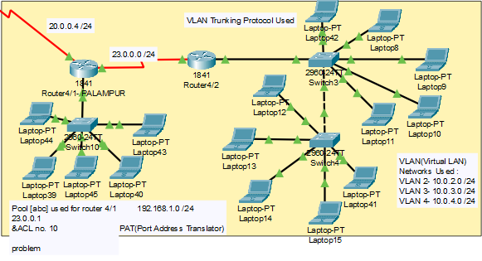
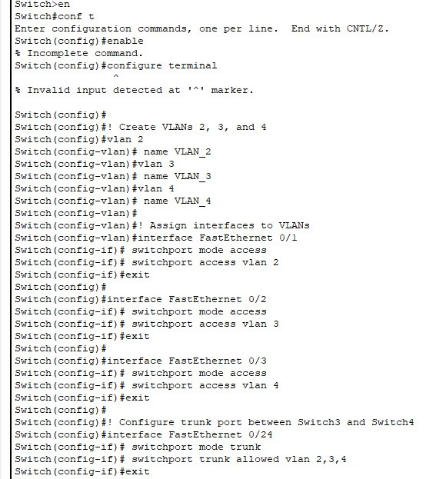
VLANS
AND
PAT

Slide 5
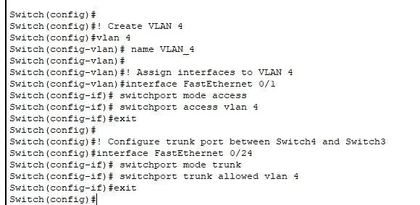
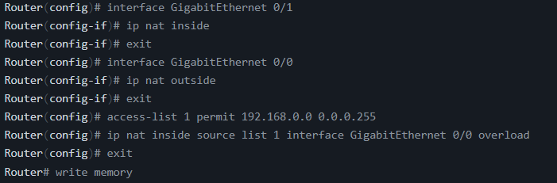

VLANS
AND
PAT

Slide 6
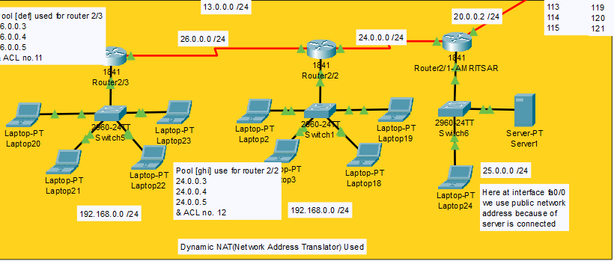
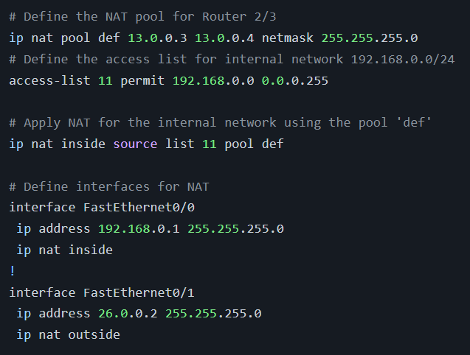
DYNAMIC NAT

Slide 7
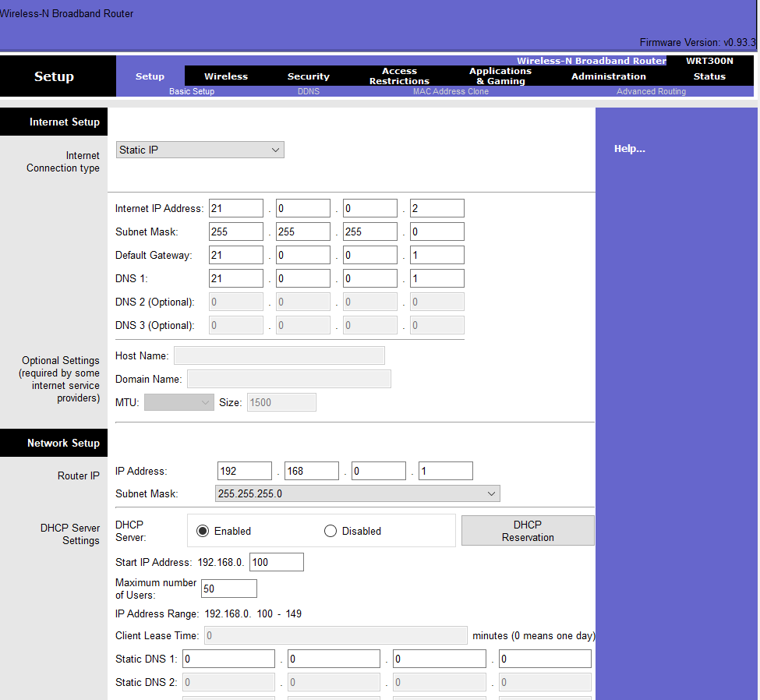
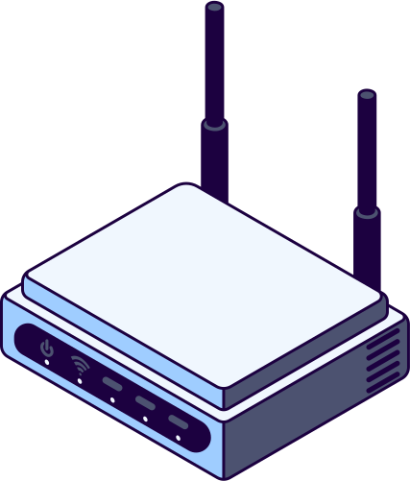

WIRELESS

Slide 8

Thank You
Zeyad Hani Mahmoud
Abdullah elsayed mohamed
Mohamed Othman Abdelazeem
Osama Mamdouh Tawfik

